Slide 1
Angular 8 - Day 3
Components, Directives, and Routes

Slide 2

Objectives
In this session we will be accomplishing the following goals:
Understand and Create Components
Add Bio Component to HelloAngular
Developer class
bio.component.ts
bio.component.html
Display bio in app.component.html
Discuss Component LifeCycle Hooks
Discuss and implement other bindings
Discuss and implement structural directives
Intro to Routes
Implement Routing in HelloAngular

Slide 3
Components

Slide 4
Components
Components form the building blocks of an Angular application.
A component controls a patch of the screen’s real estate, called a view, and declares reusable UI building blocks for the application.
In effect, the whole application can be modeled as a tree using these components.
Components are visible to the end user and can be reused multiple times within the application.
To create a Component, issue the following command
$ ng g component <<ComponentName>>

Slide 5
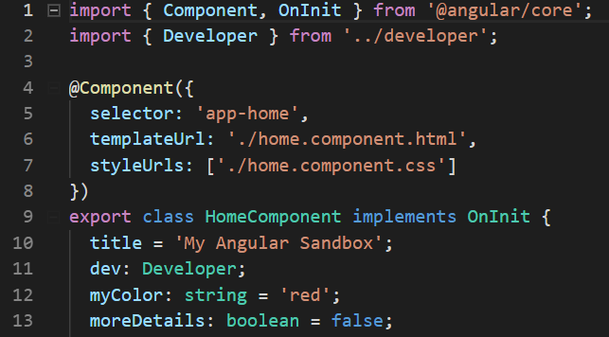
Creating Components
A Component is a class is decorated with the @Component, a TypeScript decorator. This enhances a class or a function definition by adding metadata to properties and function arguments.
The key constituents of the decorator include -
selector: It is the element property that indicates Angular 7 to create and insert an instance of this component.
template or templateUrl: It is a form of HTML that indicates Angular 7 on the components to be rendered in the DOM. The template property is used when you have a small portion of markup that you want to code directly the decorator. TemplateUrl is used to indicate an external markup file.
styleUrls: indicates style sheets that will be injected into the document as script tags within this component when it is rendered

Slide 6
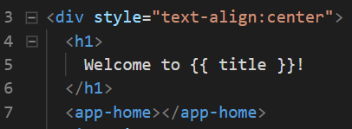
Creating Components
Display components by placing the selector in the html document.

Slide 7

Practice – HelloAngular
Make Developer Class (ng g class Developer)
firstName: string
lastName: string
favoriteLanguage: string
yearStarted: number
Make new component called ‘bio’ (ng g component bio)
Import Developer Class
Create instance of a developer inside of the constructor assign to a property called ‘dev’
Display dev component in bio.component.html
Add <app-bio></app-bio> to app.component.html
Create toggle switch using ngIF to only display bio component if link is clicked
Notes:
Instructions to Trainer:
Instructions to Facilitator:

Slide 8
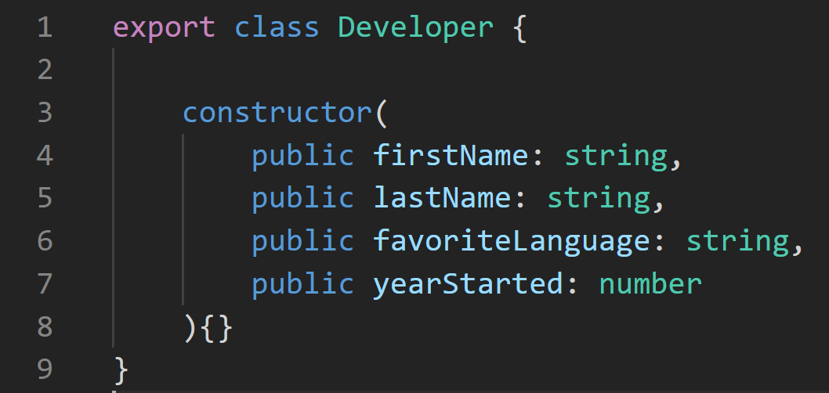
Practice – HelloAngular
Make a Developer Class
Execute ng g class Developer
Create a constructor with all of the properties as public formal parameters
Notes:
Instructions to Trainer:
Instructions to Facilitator:

Slide 9
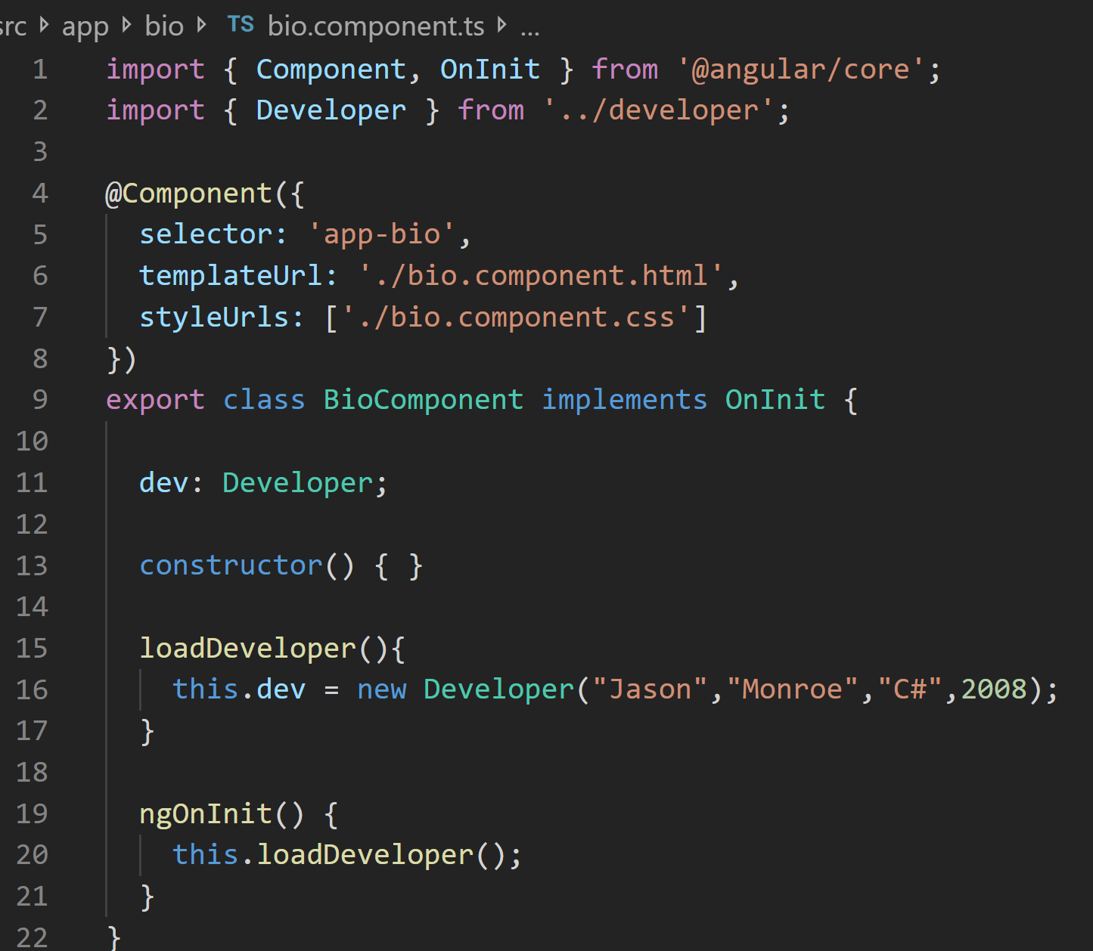
Practice – HelloAngular
Make new component called ‘bio’ (ng g component bio)
Create a dev property
Create a method called ‘loadDeveloper’ and use it to assign a new Developer instance to the dev property
Call this method from ngOnItnit()
Notes:
Instructions to Trainer:
Instructions to Facilitator:

Slide 10
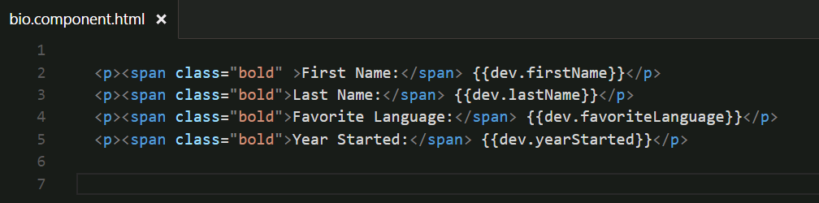
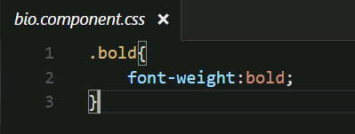
Practice – HelloAngular
Display developer attributes in bio.component.html
Add CSS rule to bio.component.css
Notes:
Instructions to Trainer:
Instructions to Facilitator:

Slide 11
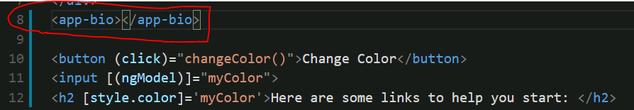
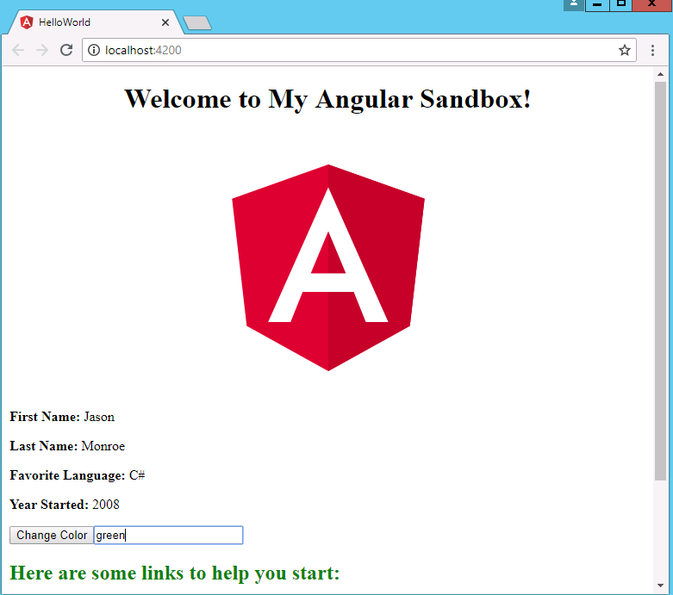
Practice – HelloAngular
Add <app-bio></app-bio> to app.component.html
Verify that your page is displaying the developer
Notes:
Instructions to Trainer:
Instructions to Facilitator:

Slide 12
Life Cycle Hooks and Structural Directives

Slide 13
Component Lifecycle
The lifecycle of a component is managed by Angular itself.
It manages creation, rendering, binding data-bound properties etc. and also offers the feature “hooks” that allows responding to key lifecycle events.
Here is the complete lifecycle hook interface inventory:
ngOnChanges - called when an input binding value changes.
ngOnInit - called after the first ngOnChanges.
ngDoCheck - called after every run of change detection.
ngAfterContentInit - called after the component content is initialized.
ngAfterContentChecked - called after every check of component content.
ngAfterViewInit - called after the component's view(s) are initialized.
ngAfterViewChecked - called after every check of a component's view(s).
ngOnDestroy - called just before the component is destroyed.

Slide 14
Other Bindings
Elvis Operator:
If a property, that does not exist, is referenced in a template, an exception is thrown.
The “Elvis Operator” is a simple and easy way to guard against null and undefined properties.
It is denoted by a question mark immediately followed by a period “?.”.
<md-input-container>
<label>Type to see the value</label>
<input md-input type="text" />
</md-input-container>
<strong>{{input?.value}}</strong>

Slide 15
Structural Directives
Angular uses directives to transform the DOM when a template is rendered.
ngIf adds and removes elements in the DOM based on the results of an expression.
ngFor is a repeater directive which outputs a list of elements by iterating over an array.
<if-example *ngIf="exists">Hello</if-example>
<app-for-example *ngFor="let episode of episodes" [episode]="episode">
{{episode.title}}
</app-for-example>

Slide 16
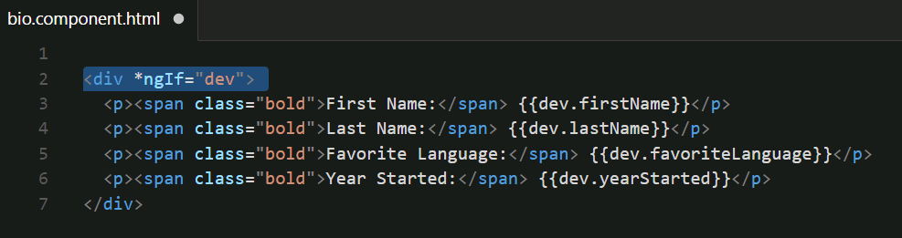
*ngIf
*ngIf will render the html tag and all nested tags if the attribute value is defined or ‘true’ if it is a Boolean type.

Slide 17
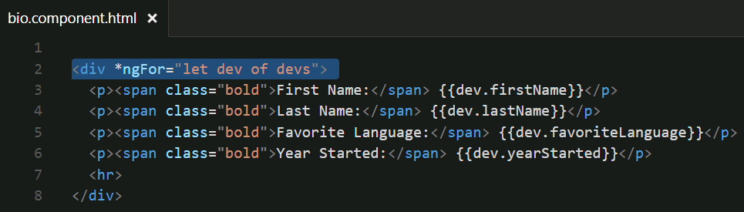
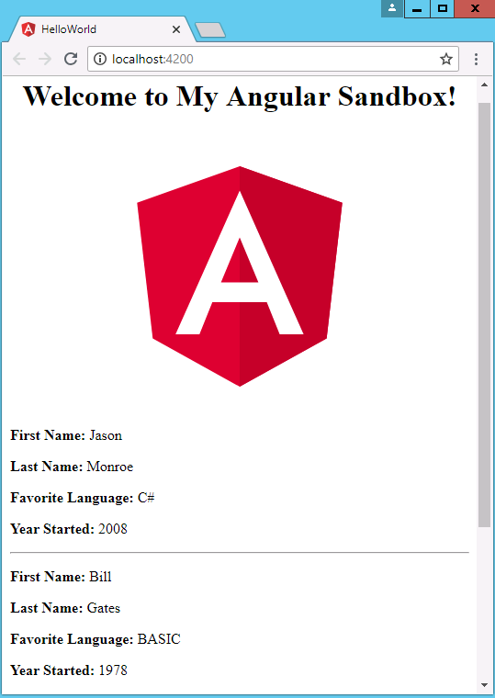
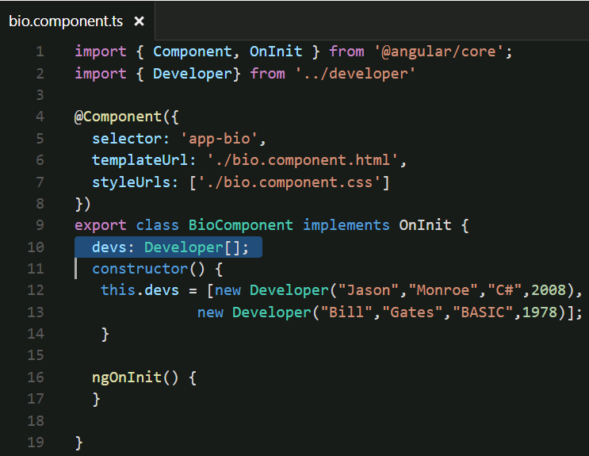
*ngFor
*ngFor will render the html tag and all nested tags for every element in an array.

Slide 18
Routing

Slide 19
Introduction to Routes
Routing provides the ability to encode some aspects of the application's state in the URL.
Adding routing, allows the user to go straight into certain aspects of the application. This is very convenient, as it can keep the application linkable and bookmarkable and allow users to share links with others.
Routing allows to:
Maintain the state of the application.
Implement modular applications.
Implement the application based on the roles (certain roles have access to certain URLs).
Routes are injected into <router-outlet></router-outlet>. This is most commonly placed in app.component.html below any navigation bars or content that you want to appear on every page

Slide 20
App Routing Module
You can add routing after the fact
Angular best practice is to create a separate, top-level module dedicated to routing
- - flat flag will place the module in the top level
- - module=app will add the import for app-routing inside of AppModule
ng g module app-routing - -flat - -module=app

Slide 21
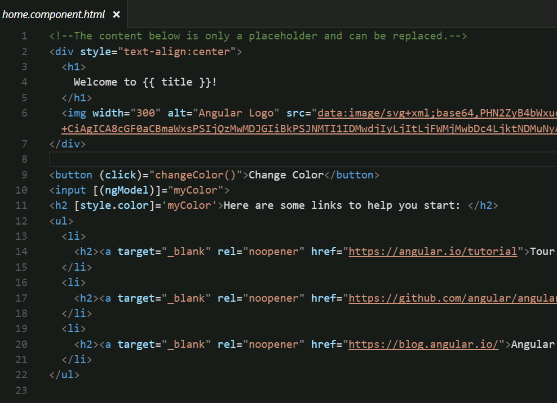
HelloAngular home.component.html
Migrate content from app.component.html here

Slide 22
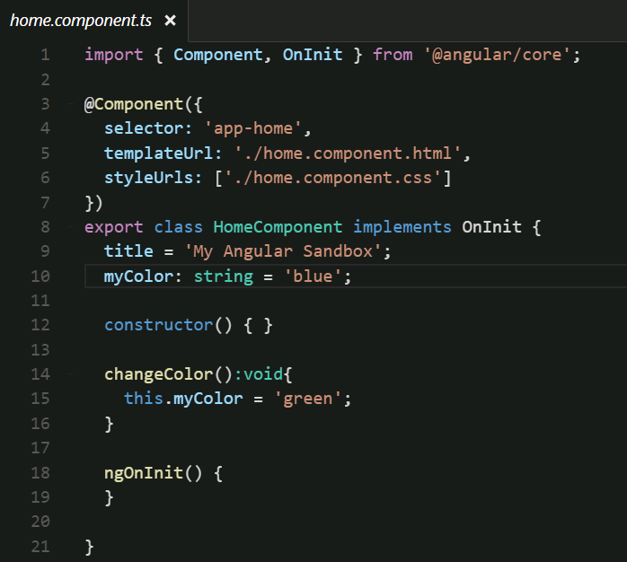
HelloAngular HomeComponent
Migrate content from AppComponent
(just the class properties and methods not the @Component stuff)

Slide 23
Route Configuration
The Base URL tag must be set within the <head> tag of index.html.
Routes are configured, using the Routes type, which is an array of route objects. The route object is composed of the following attributes:
Path: URL to be shown in the browser when application is on the specific route.
Component: Component to be rendered to, when the application is on the specific route. This is the output of the router link.
redirectTo: Redirect route if needed; each route can have either component or a redirect attribute defined.
pathMatch: Optional property that defaults to 'prefix'; determines, whether to match full URLs, or just the beginning. When defining a route with empty path string set pathMatch to 'full', otherwise it will match all URLs.
children - Array of route definitions objects, representing the child routes of this route.

Slide 24
Route Configuration (Contd.)
Define the routes array and send it as an arg to the RouterModule to build the configuration.
const routes: Routes = [
{ path: 'component-one', component: ComponentOne },
{ path: 'component-two', component: ComponentTwo }
];
export const routing = RouterModule.forRoot(routes);
Angular picks the empty path, as the default landing route.
Routes may redirect to other routes, using the redirectTo attribute.
export const routes: Routes = [
{ path: '', redirectTo: 'component-one', pathMatch: 'full' },
{ path: 'component-one', component: ComponentOne },
{ path: 'component-two', component: ComponentTwo }
];

Slide 25
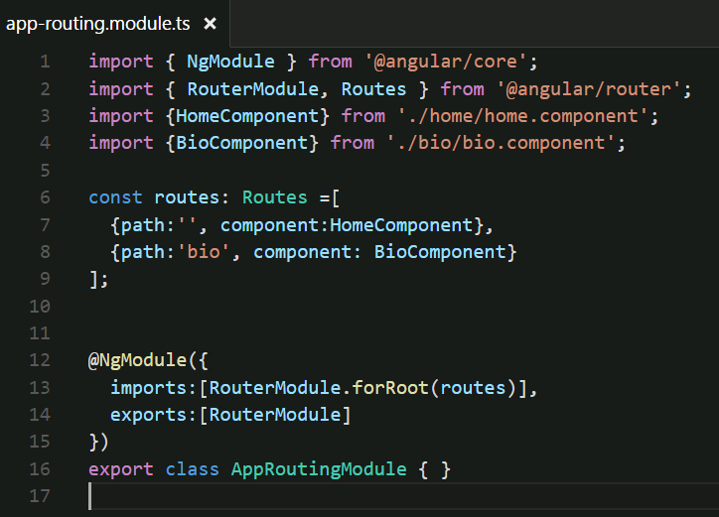
app-routing.module.ts

Slide 26
Route Navigation
In the view template, routerLink directive may be used to add links that point to the defined routes.
<a routerLink="/component-one">Component One</a>
To navigate programmatically, the router’s navigate method may be used.
router.navigate(['/component-one']);

Slide 27
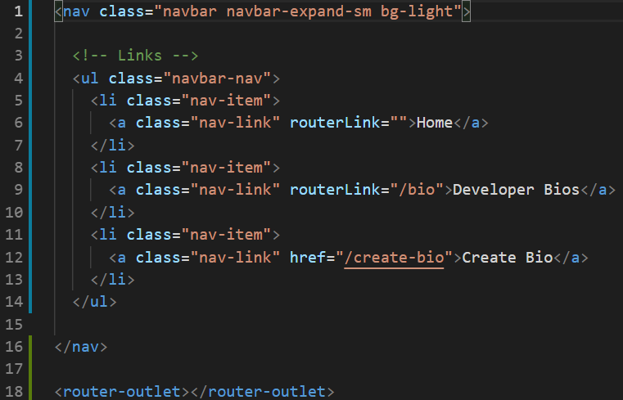
Route Navigation
Angular dynamically adds the component for the route being activated into the <router-outlet></router-outlet> element.
This is commonly placed in the app.component.html template along with any elements that need to be on every page, such as a navigation bar
Add bootstrap cdn link to index.html to render Bootstrap css elements

Slide 28
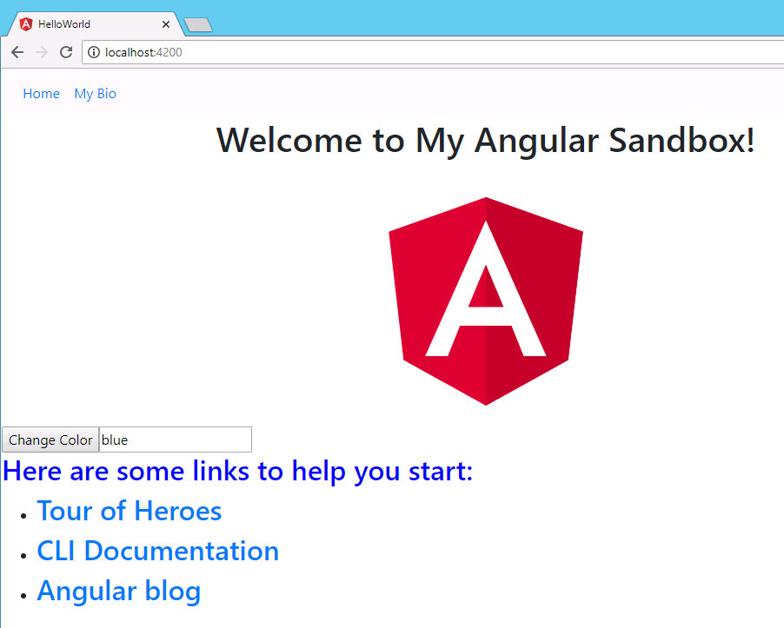
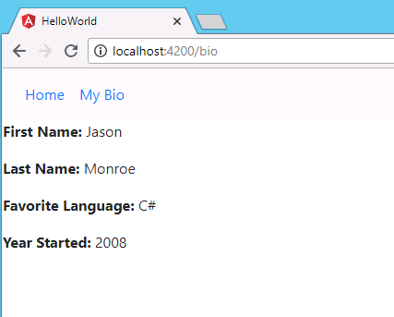
Routes in Action
Notes:
Instructions to Trainer:
Instructions to Facilitator:

Slide 29
Practice – HelloAngular
Make your own component and call it whatever you like
Add some content to your component html view
Add any backing data you need for your component view in its accompanying component class
Add your component to the routes in app-routing.module.ts
Add a link to your nav bar in app.component.html
Notes:
Instructions to Trainer:
Instructions to Facilitator:

Slide 30


Questions

Slide 31
You have successfully completed
Angular Components, Directives, and Routes

Slide 32
Thank You

